Slide 1

DEMAND ANALYSIS
Fabian Umeh

Slide 2
BACKGROUND
Student at Teesside University
Data scientist
&
Petroleum Engineer

Slide 3
ABOUT
The analysis is focused on the development of a prediction model to properly plan energy producing operations and balance demand with adequate supply. An accurate prediction can assist in managing day-to-day operations, fulfilling customers' energy demands, and preventing surplus energy generation.

Slide 4
What the study covers
Do
Little Market understanding from guest lecture
Daily demand as a case study
Supervised learning tasks
Feature selection and engineering
Does Not
Feature forecast
Traditional forecast model
Feature decomposition and de-trending (For traditional forecasting models)

Slide 5
Key assumptions of study
Daily demand prediction tasks are different from monthly, quarterly and yearly prediction.
Working days and non-working days have proven key to study
Temperature a key factor but not independent of itself in demand prediction.

Slide 6
Project work flow
Data formatting.
Handling Missing values.
Creation of Useful data from raw data.
Data Preparation
EDA
The Demand and Temperature correlation
Feature Engineering
OLS, Linear Regression, Random Forest and KNN
Persistent test, One year, one week, one hour.
MLP & CNN model.
Model design
Model capability
One hour ahead forecast.
24hrs ahead forecast.
48hrs ahead forecast.

Slide 7
Data preparation
Feature Extraction
Frances’ Holiday
The day of the year, week, hour and month were extracted from the date column
Frances’ holiday was further incorporated to elaborate working days.
Averaging Temperature
Since the temperature in France differs by location, modelling it to include greater than or less than Average temperature was used to further elaborate temperature as a feature.

Slide 8
Exploratory data analysis

Slide 9
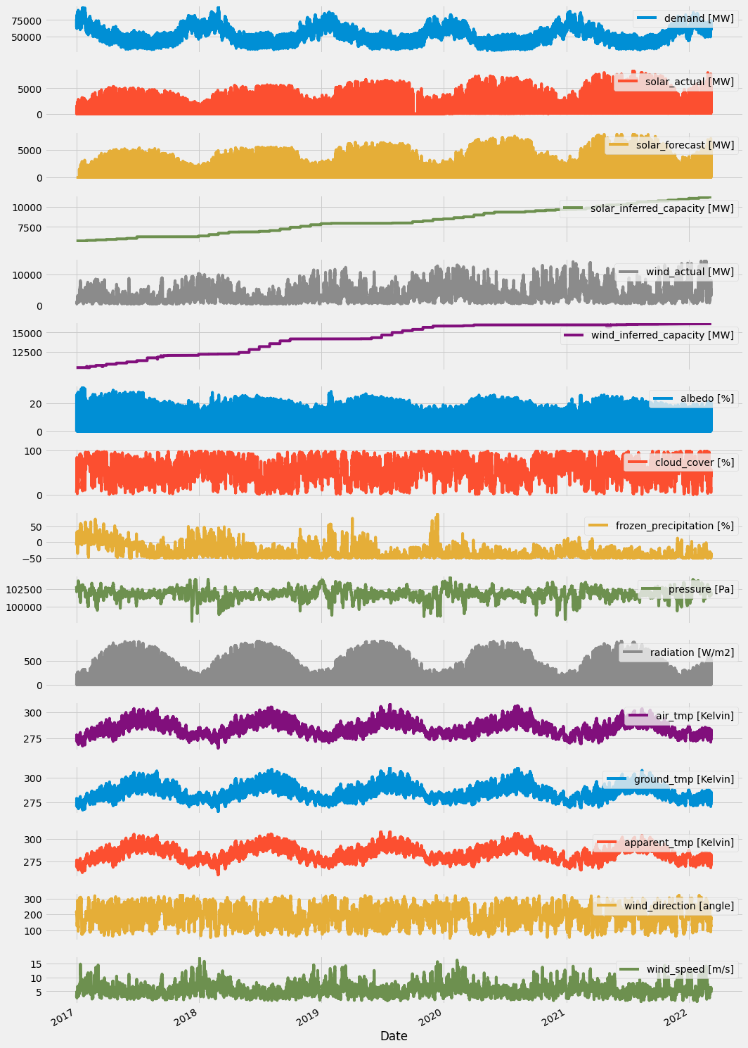
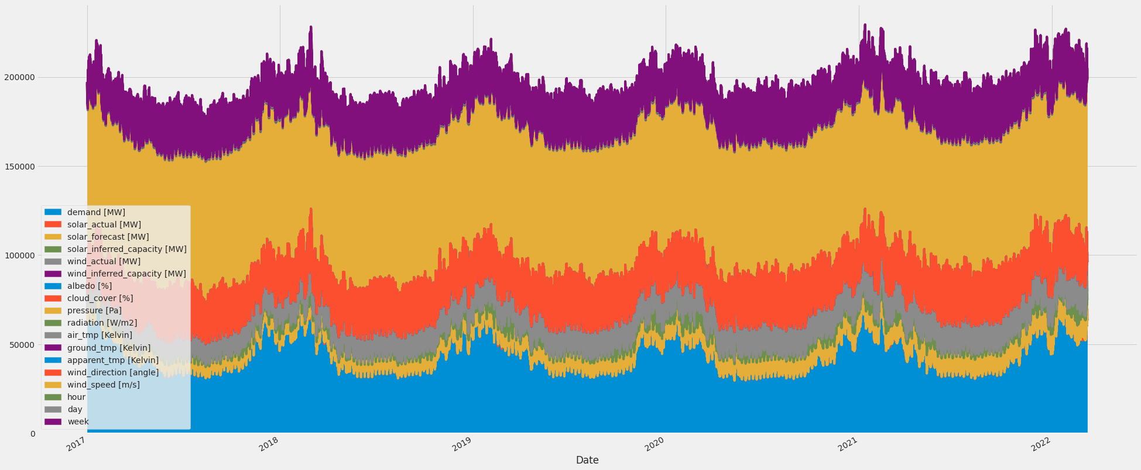
Overview of all features

Slide 10
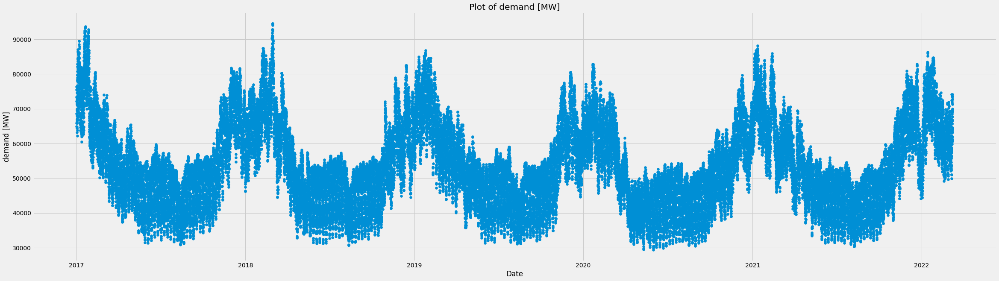
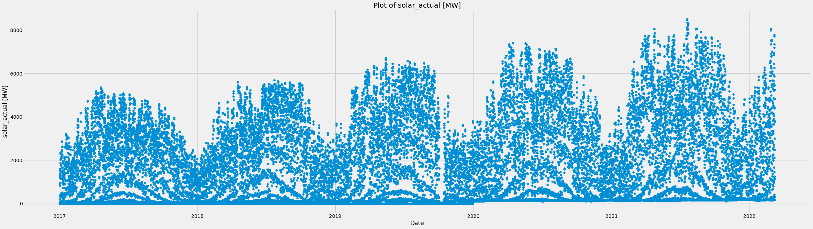

Slide 11
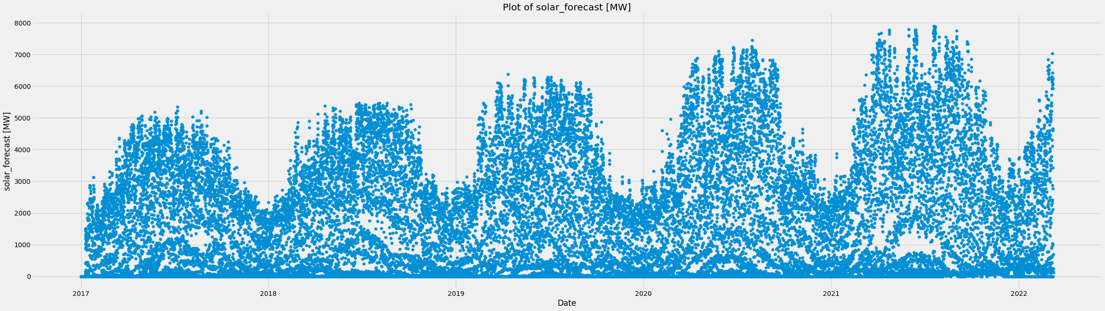
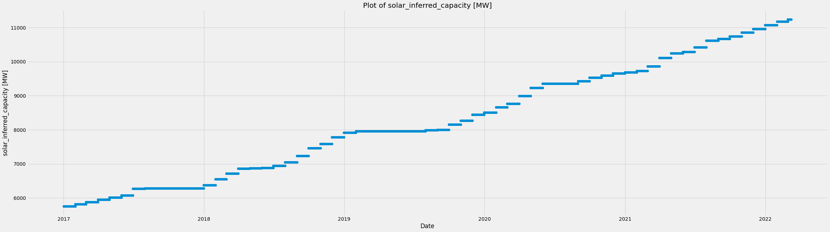

Slide 12
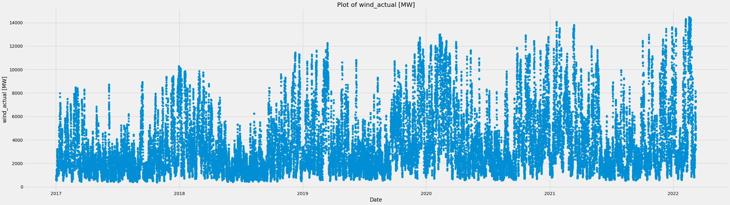
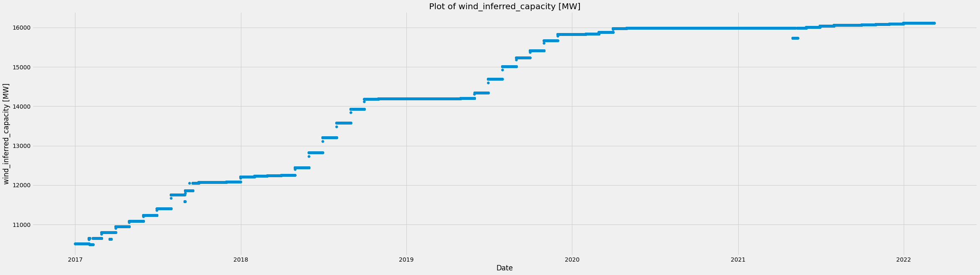

Slide 13
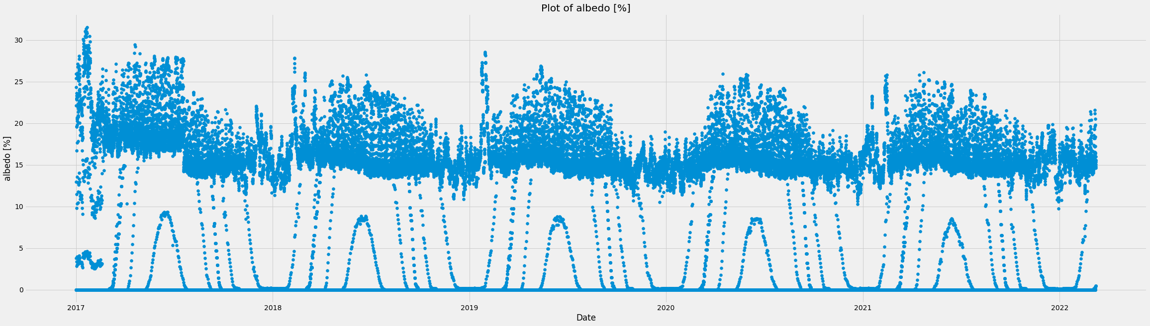
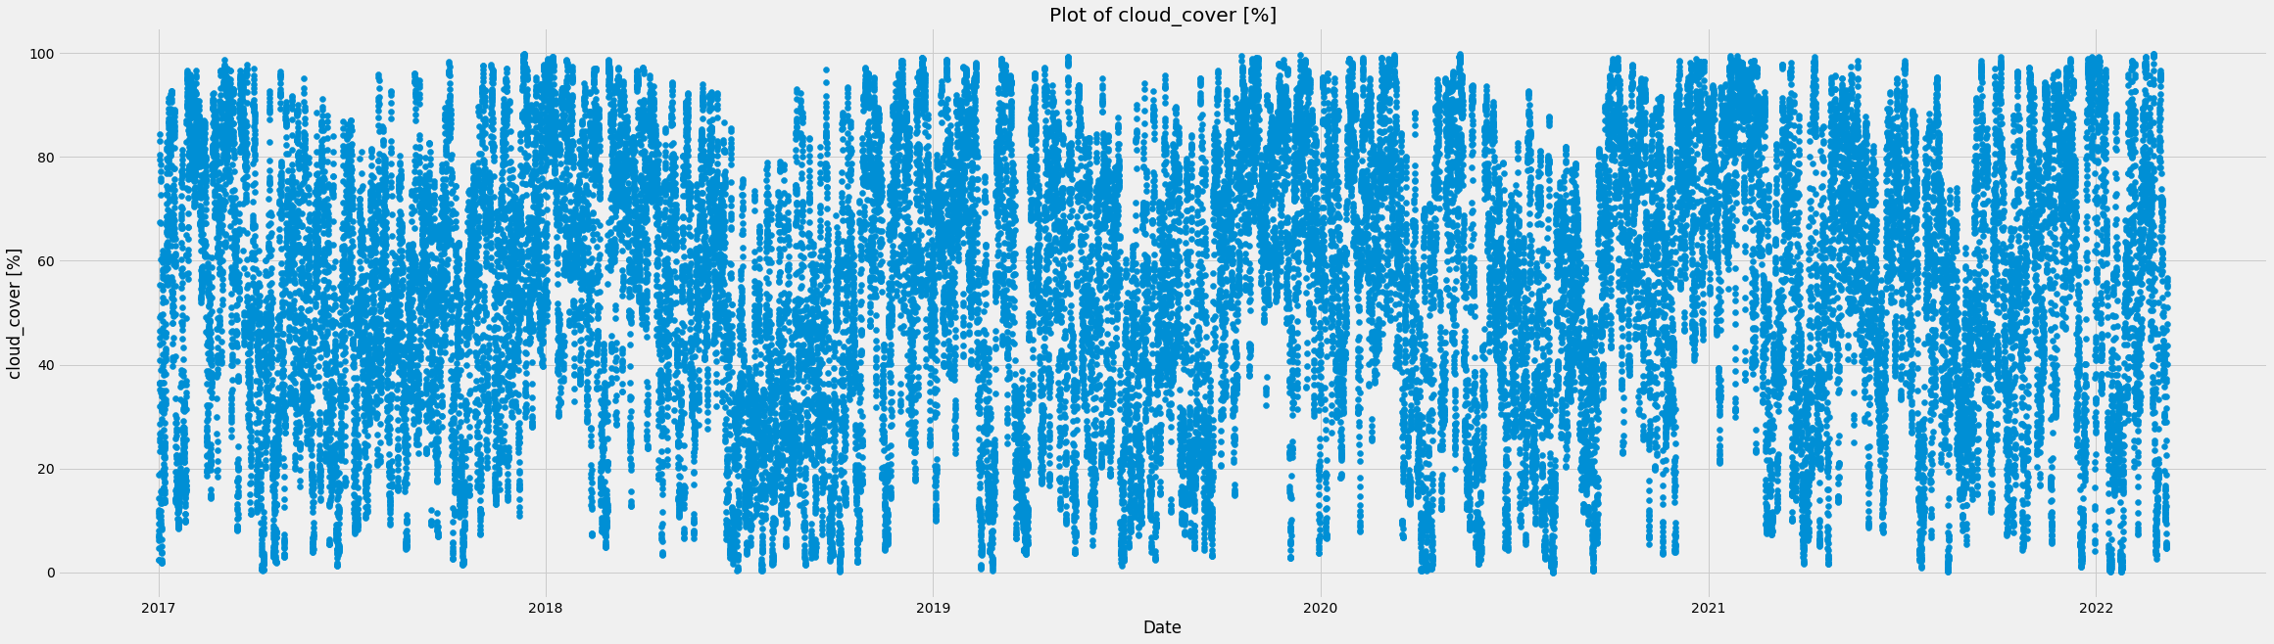

Slide 14
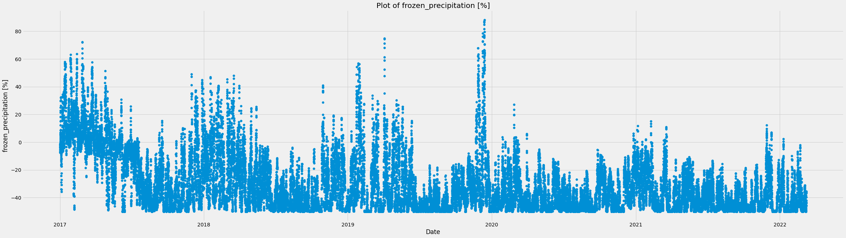
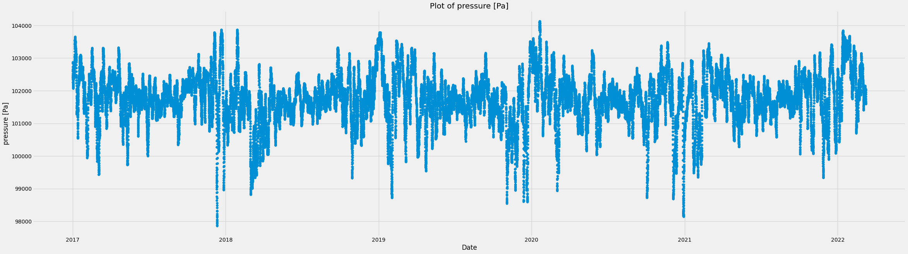

Slide 15
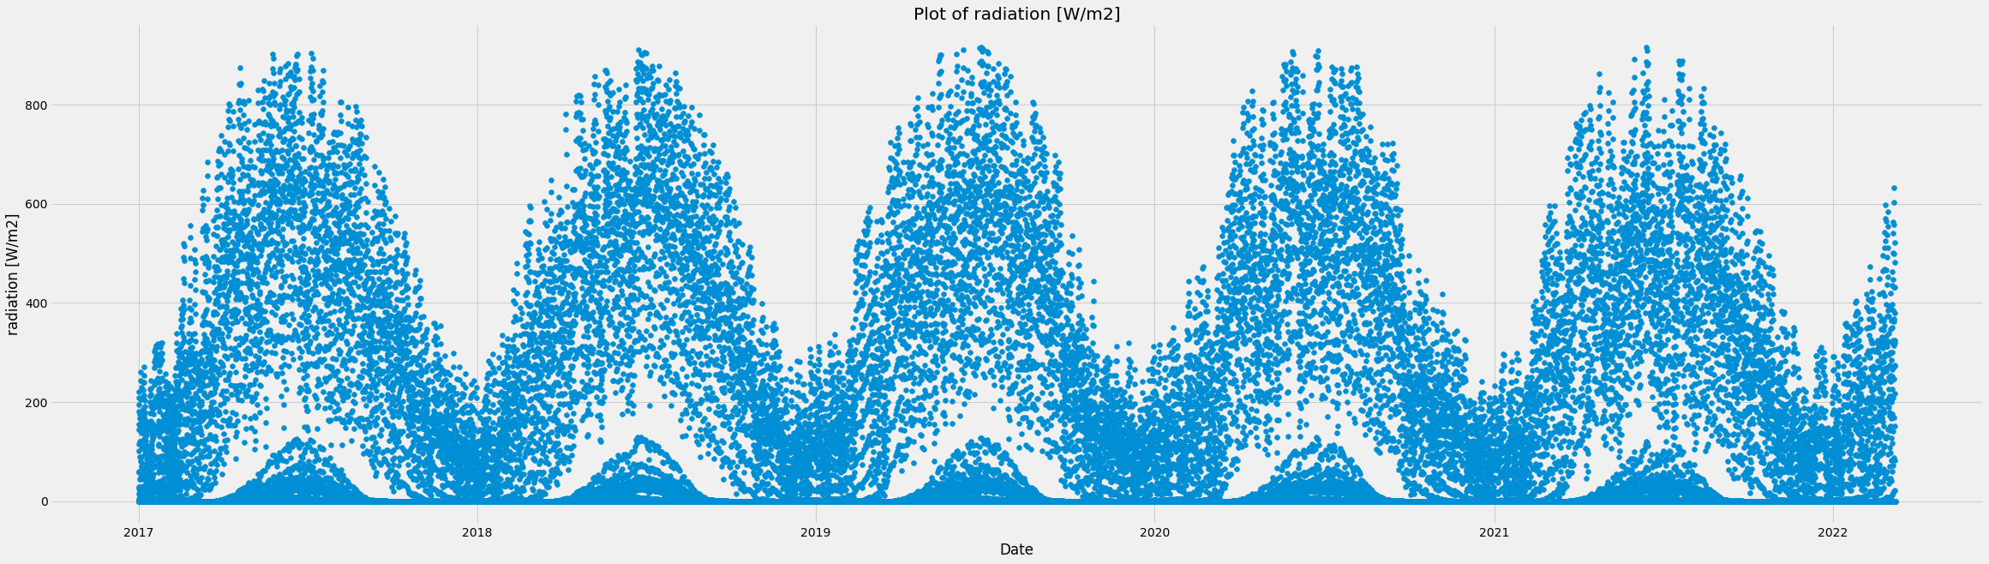
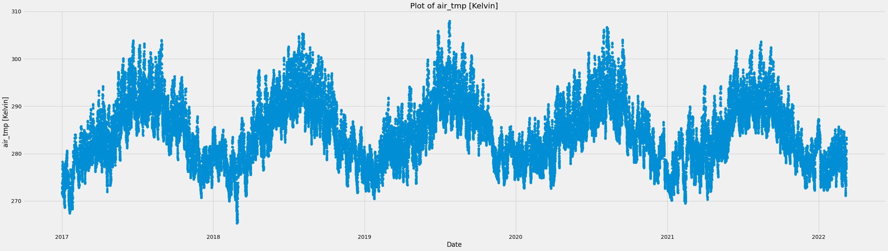

Slide 16
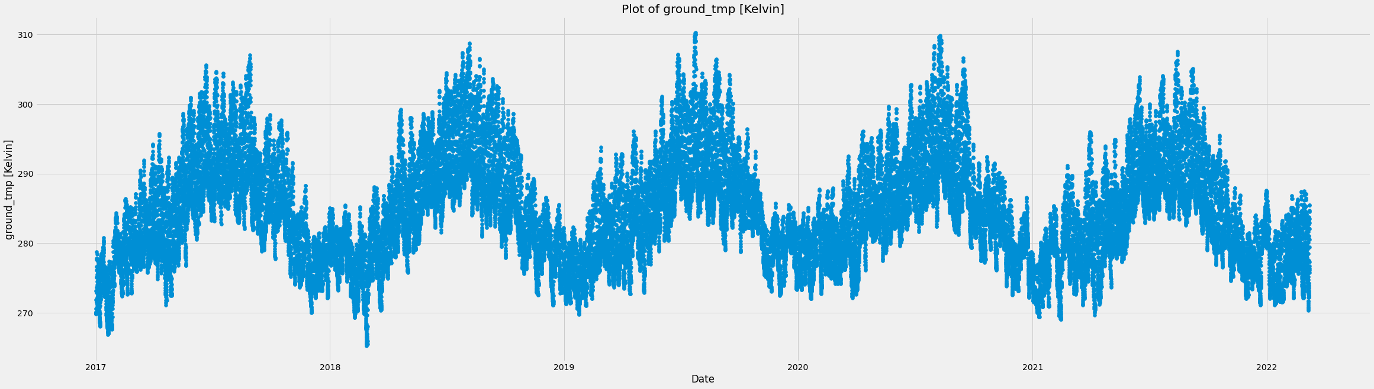
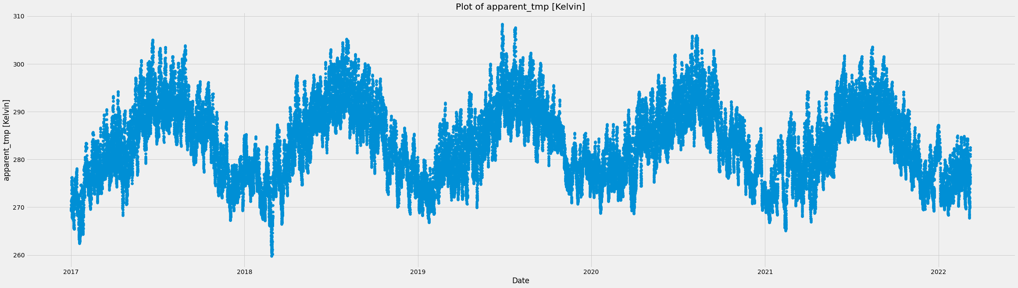

Slide 17
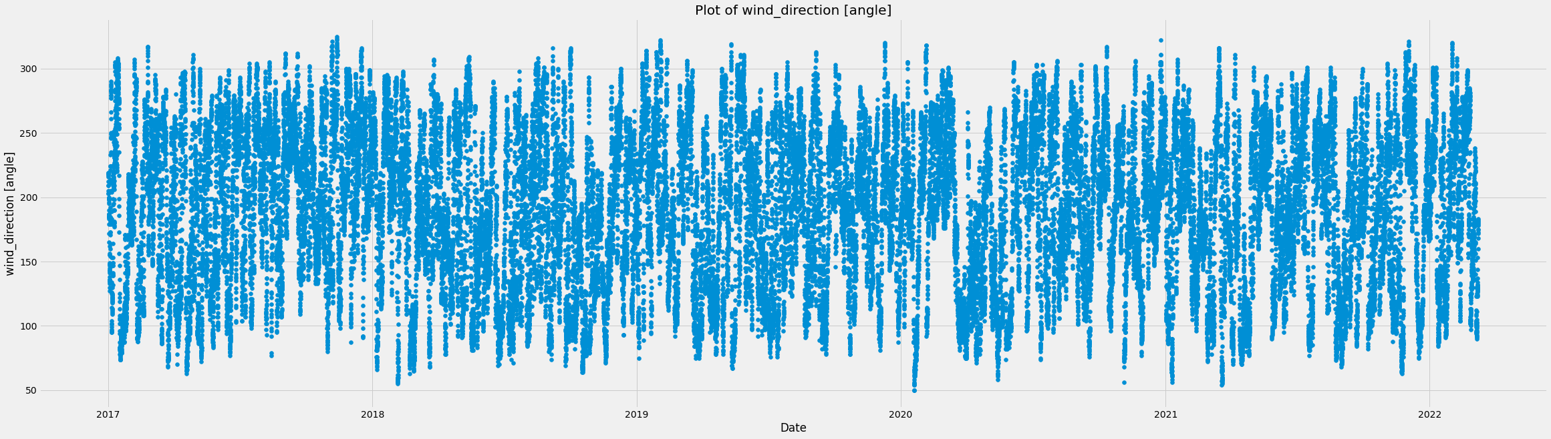
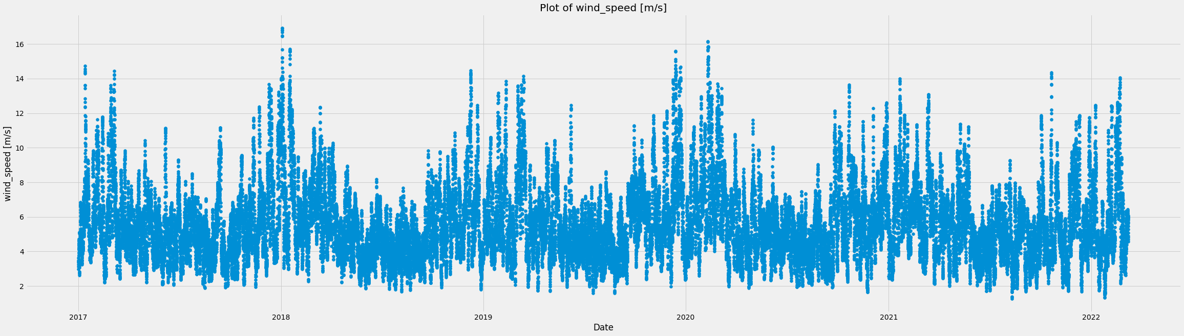

Slide 18
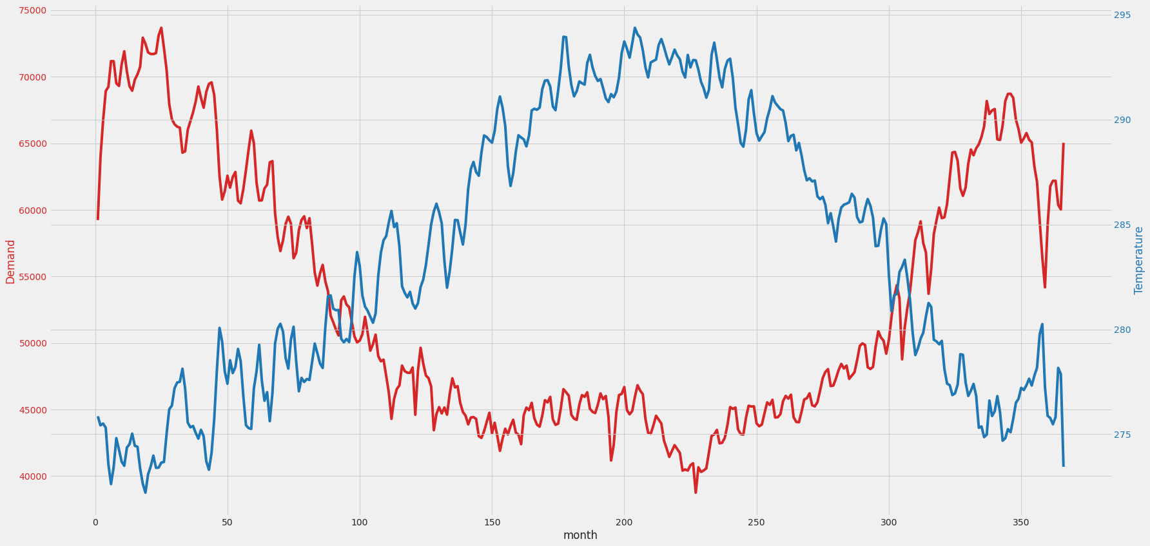
Daily Average demand and average temperature

Slide 19
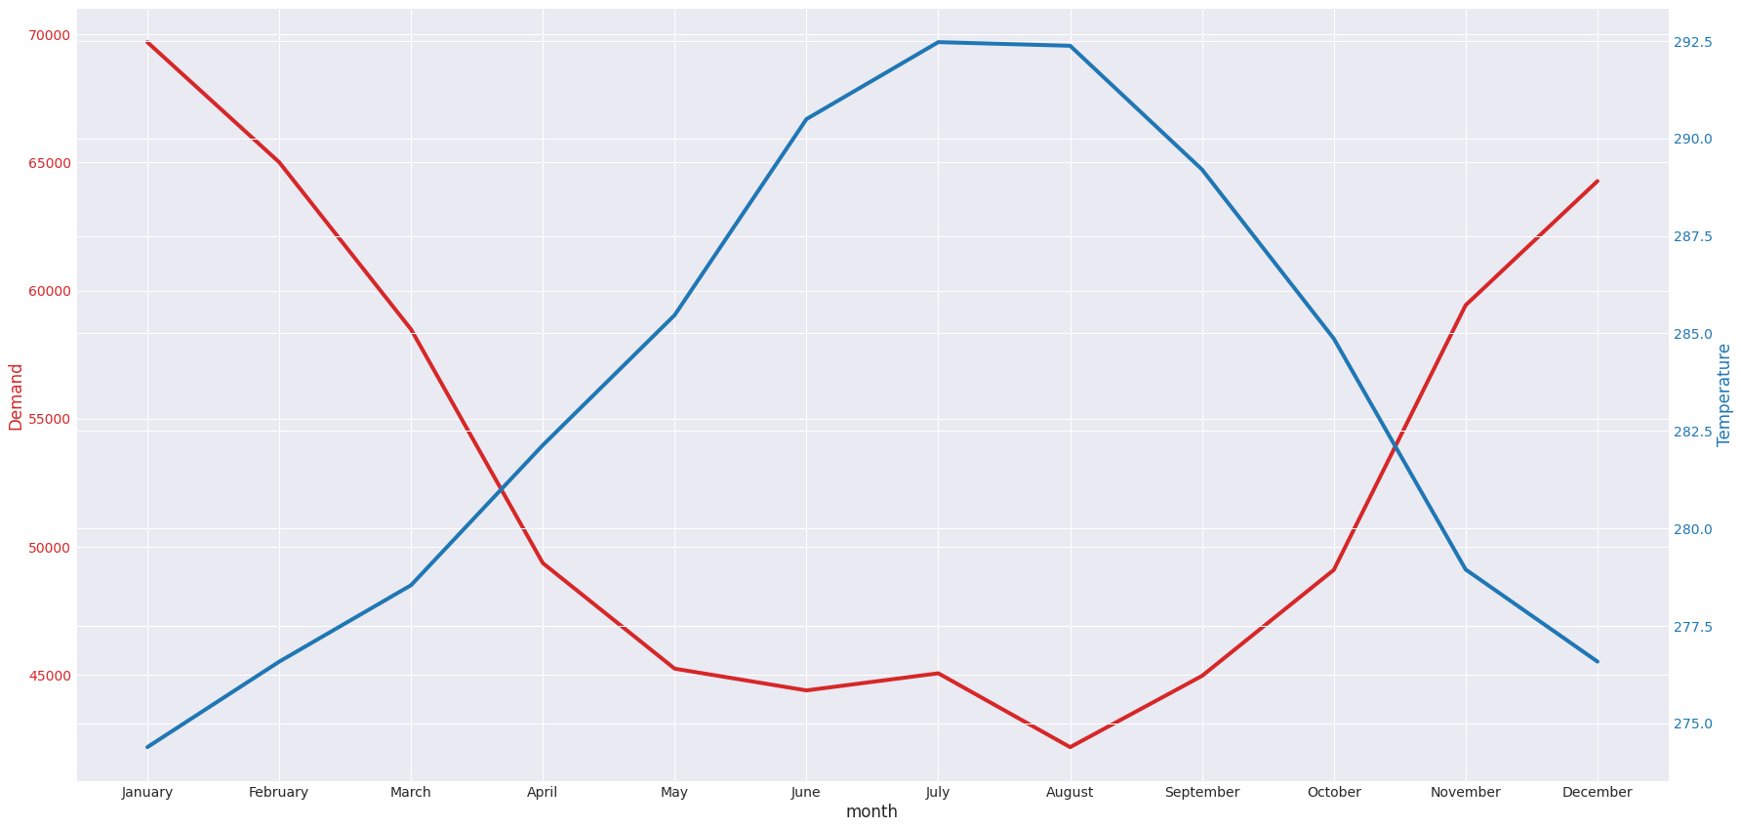
monthly Average demand and average temperature

Slide 20
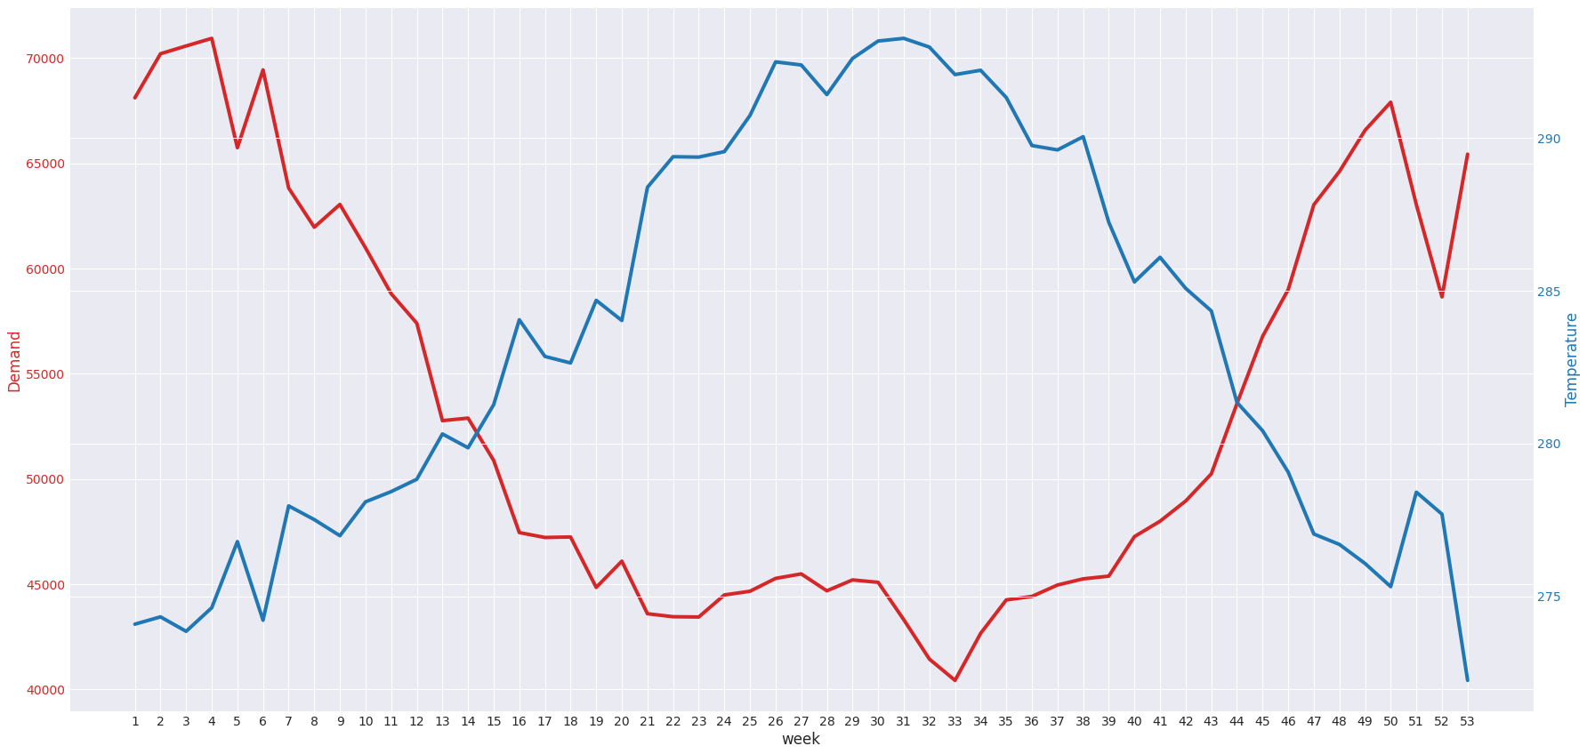
weekly Average demand and average temperature

Slide 21
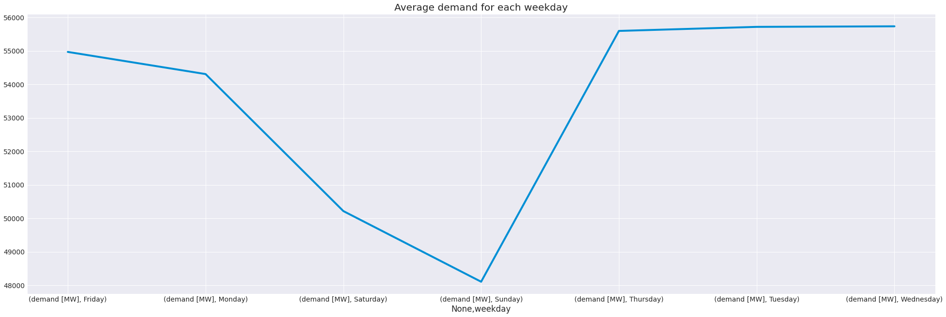
Average demand for each week day

Slide 22
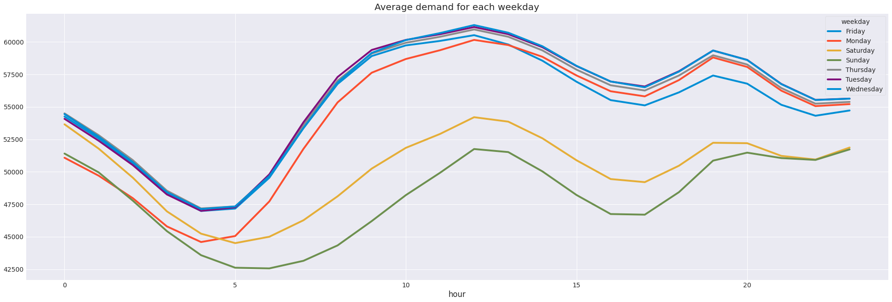
Average hourly demand for each week day
Findings: Temperature was not able to explicitly predict demand.

Slide 23
Model design

Slide 24
Machine Learning test result without lag
Ordinary Least squares regression
Accuracy: 0.895
Linear regression
Accuracy: 0.90
MAPE: 5.44%

Slide 25
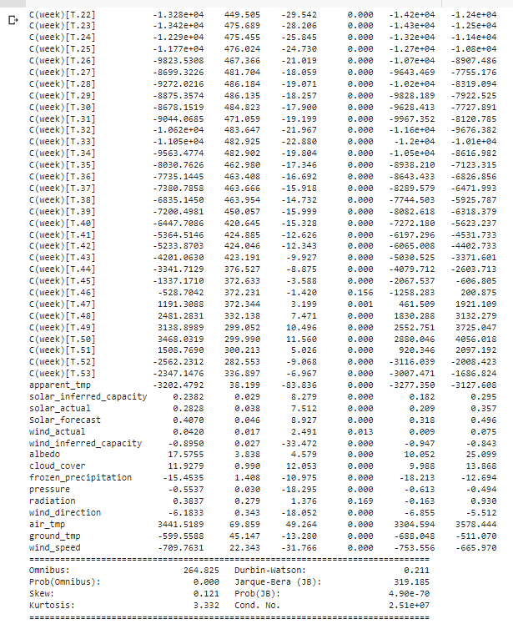
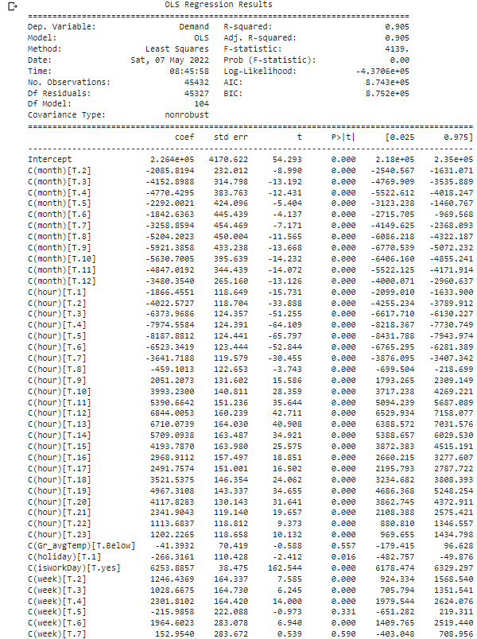
Ols model

Slide 26
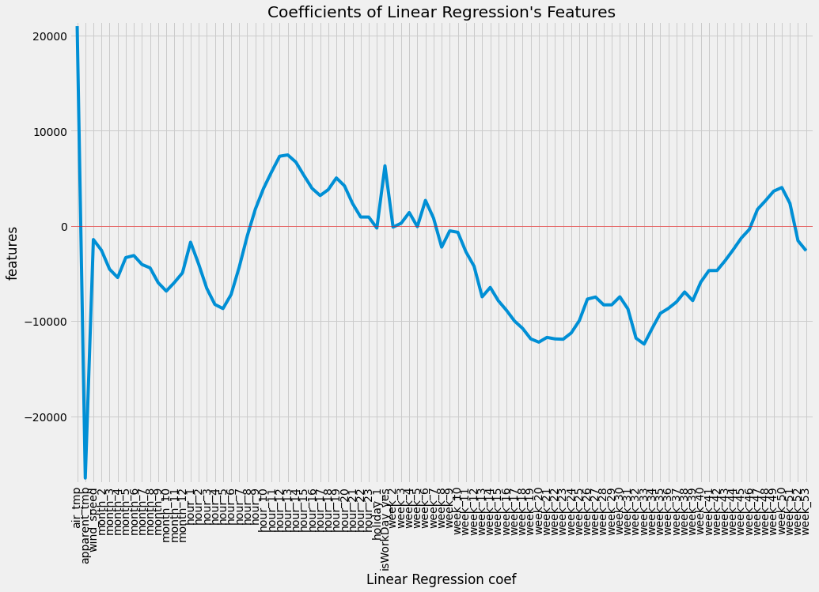
Linear regression (sklearn)

Slide 27
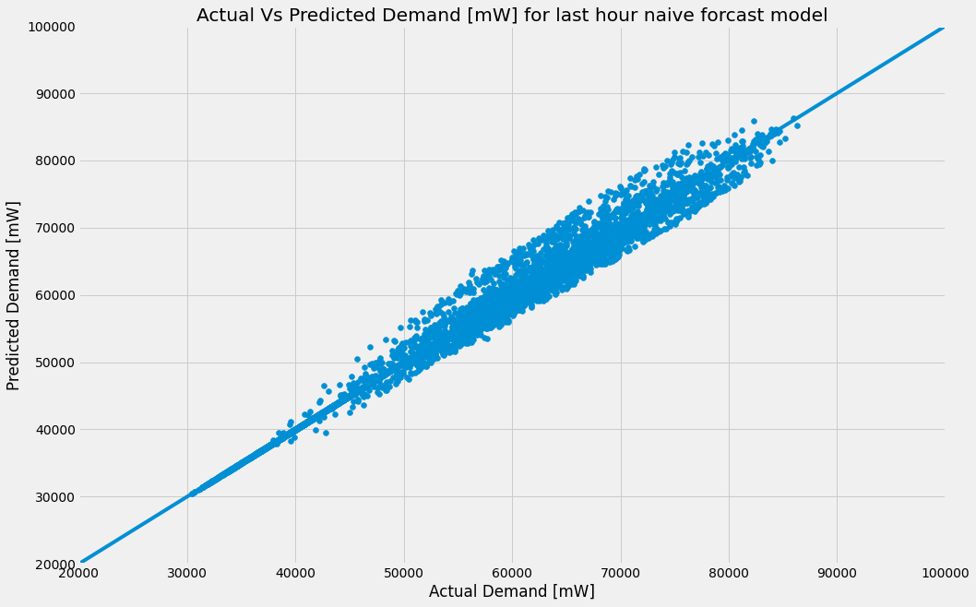
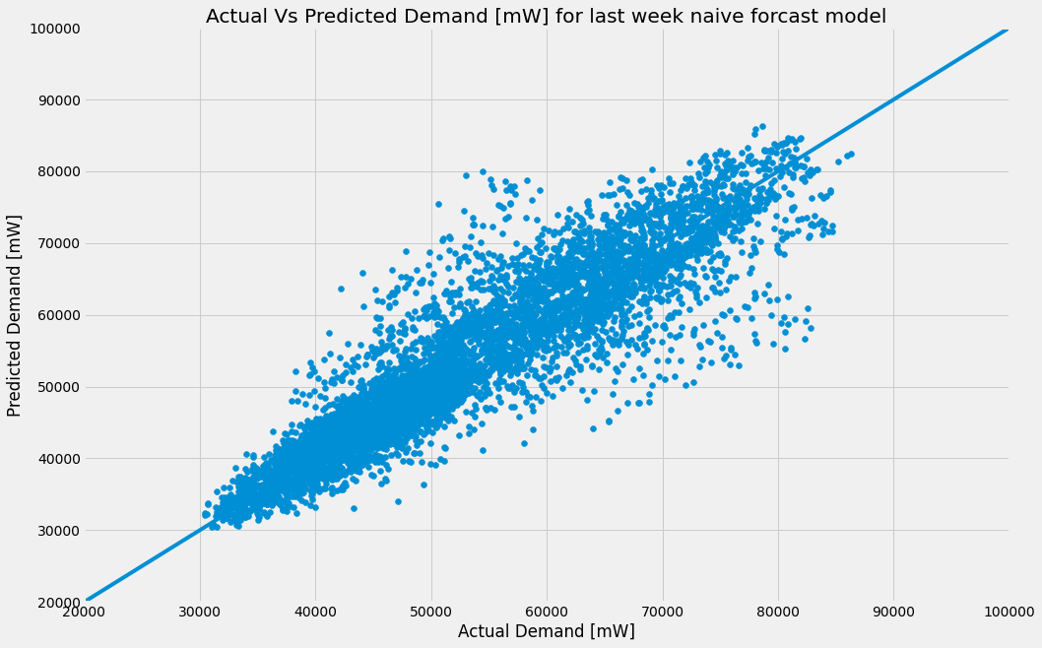
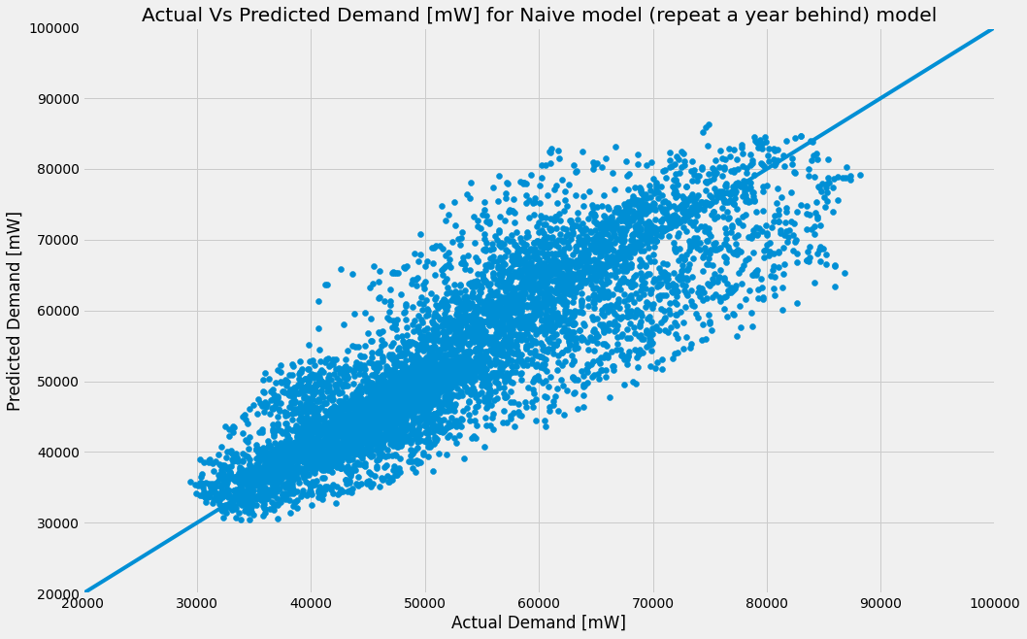
Persistent test result
One hour (exactly the same result as the previous hour)
One week (Excatly the same result as the previous week)
One year (exactly the same result as previous year)
Accuracy: 0.98
MAPE: 1.40%
Accuracy: 0.83
MAPE: 6.60%
Accuracy: 0.74
MAPE: 8.80%
Conclusion
The accuracy of the hour persistent model prompted the 24 hours lag

Slide 28
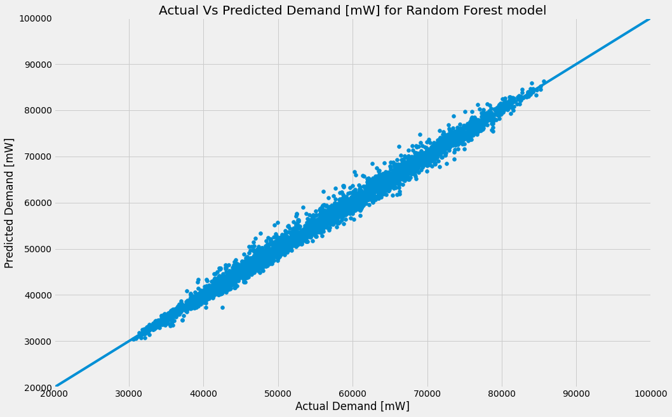
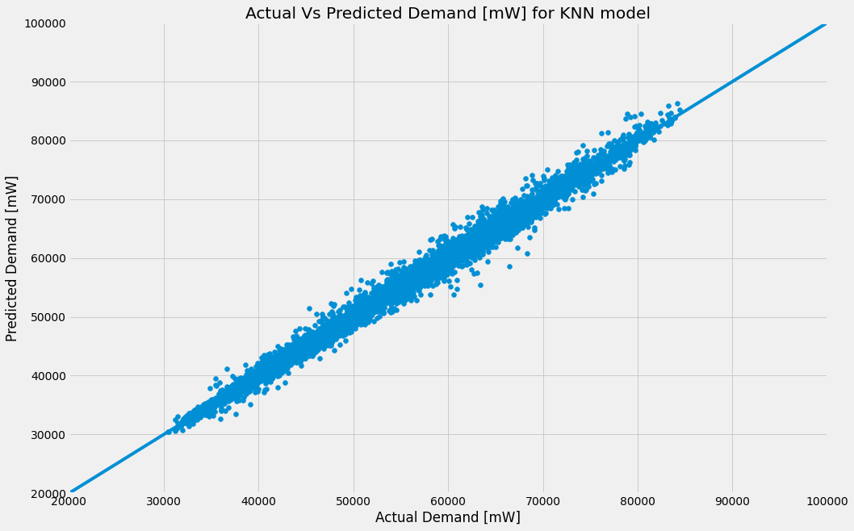
Machine Learning test result with lag
Random forest
knn
Accuracy: 0.99
MAPE: 1.42%
Accuracy: 0.99
MAPE: 1.59%
Conclusion
Addition of 24hours lag aided in better prediction

Slide 29
Forecast analysis

Slide 30
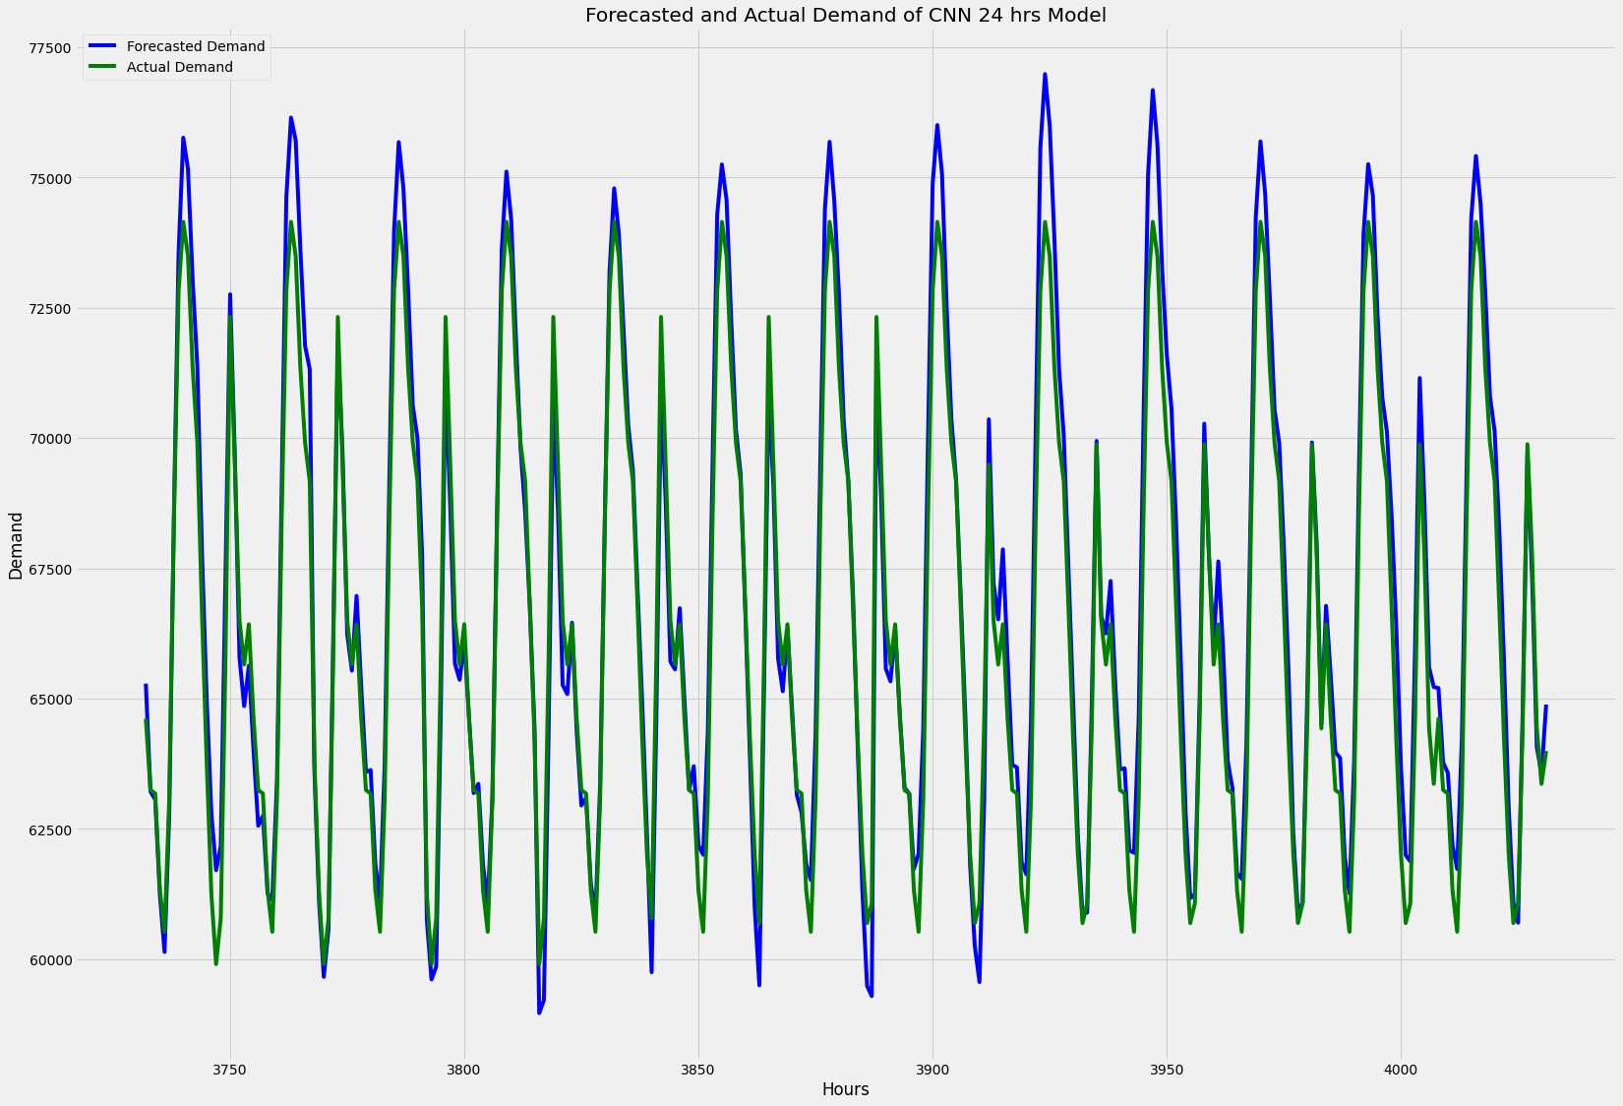
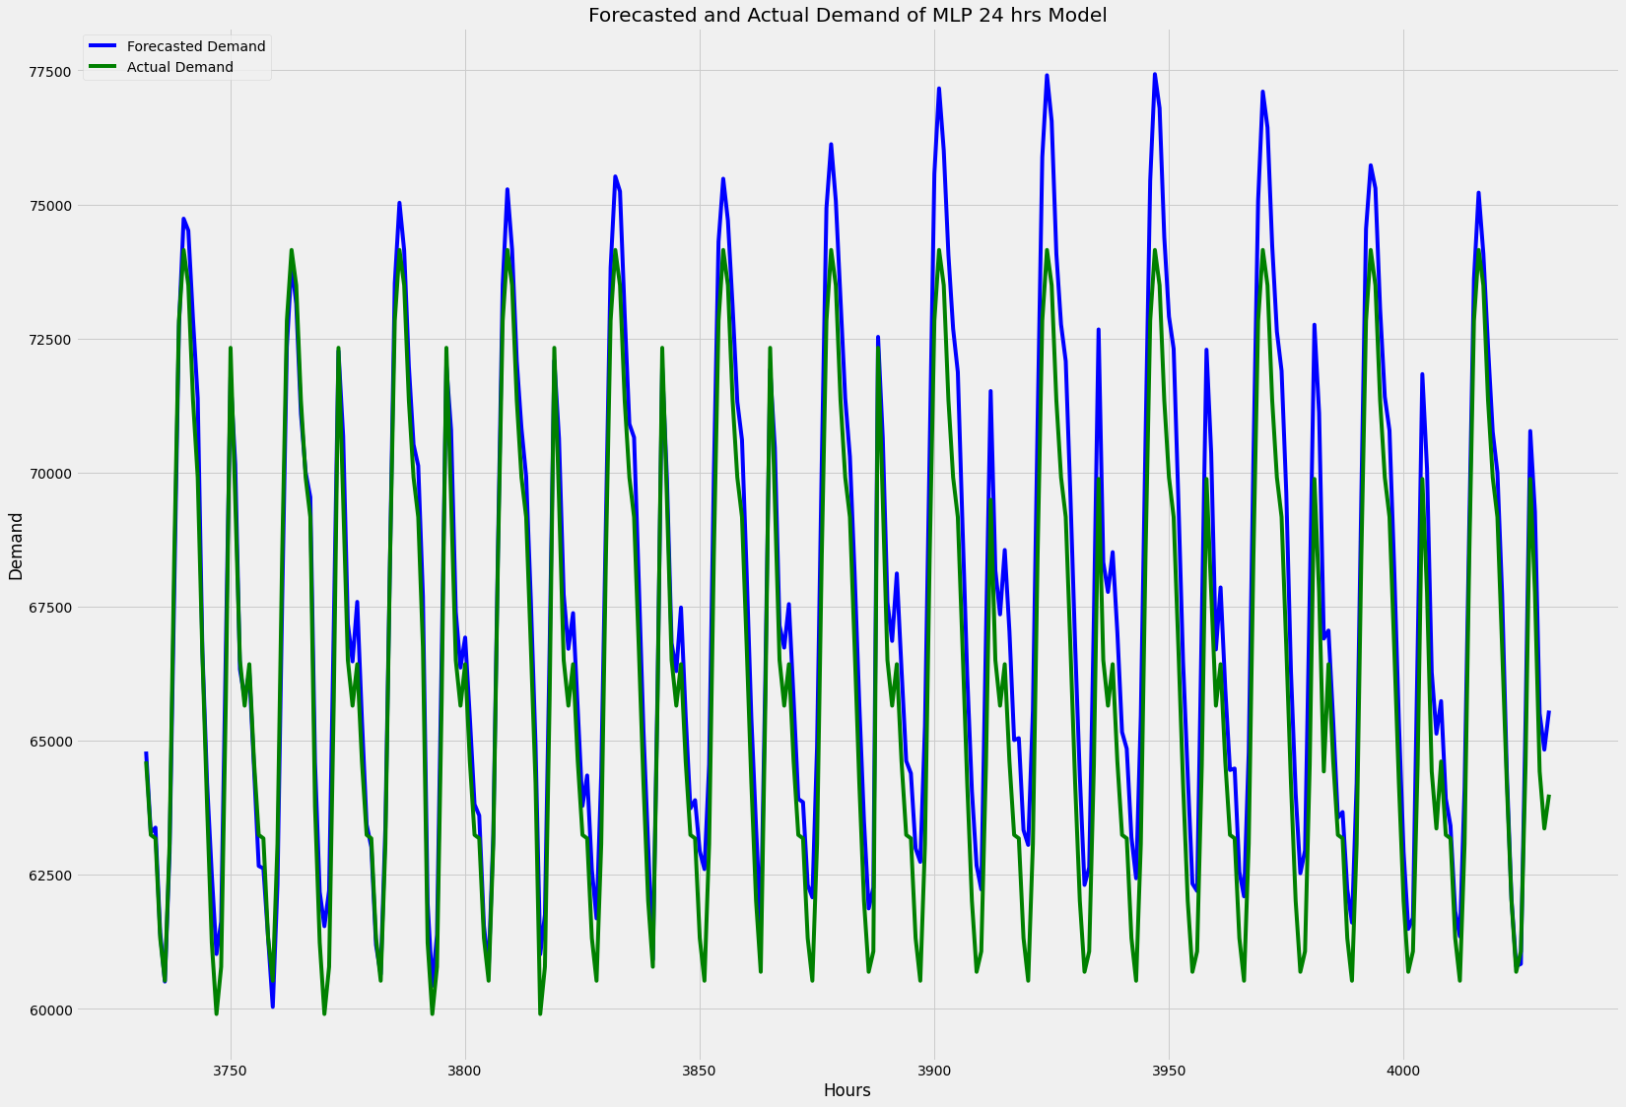
Neural network 24 hours ahead 168 samples
CNN
MAE: 1065.53
RMSE: 1384.64
MAPE: 1.73%
Accuracy: 0.934
MLP
MAE: 1111.76
RMSE: 1444.70
MAPE: 1.81%
Accuracy: 0.930

Slide 31
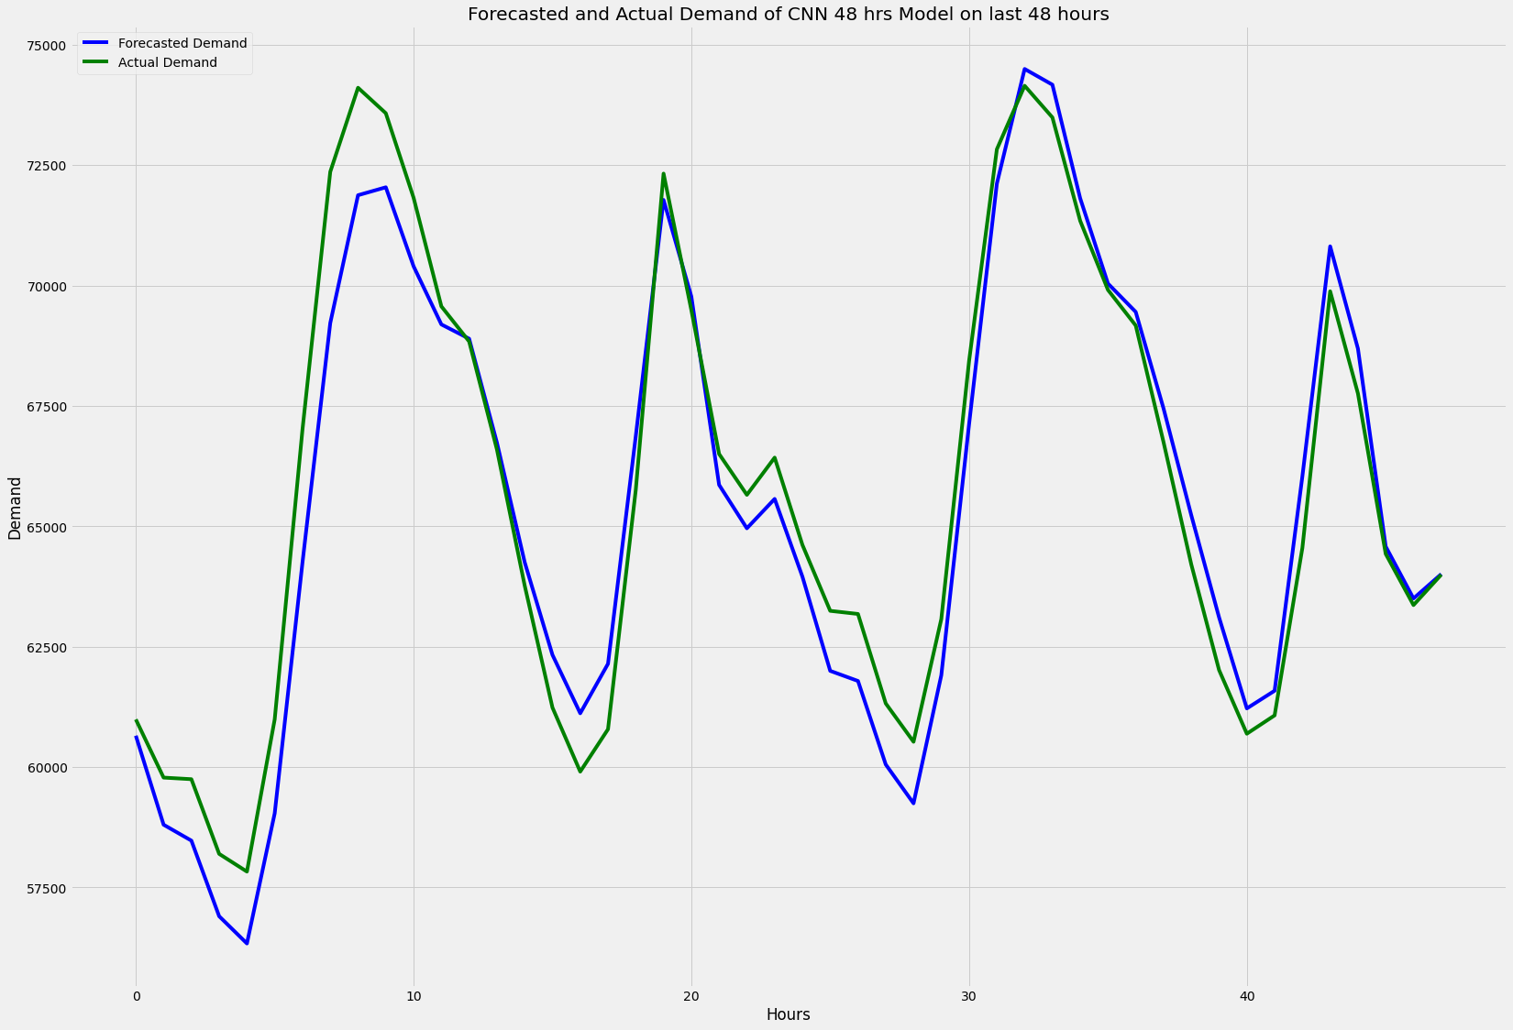
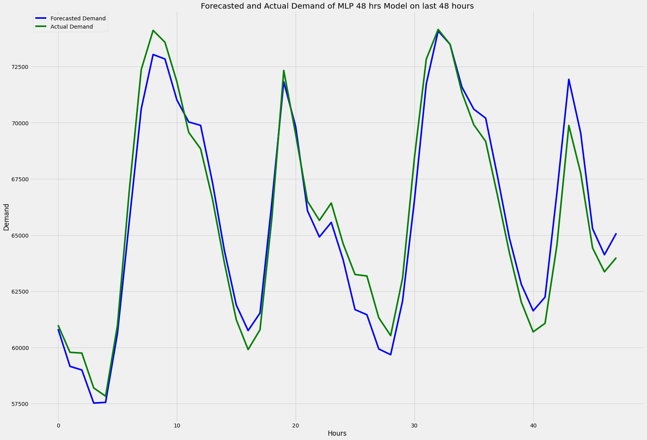
Neural network 48 hours ahead All for one
CNN
MLP
MAE: 1019.20
RMSE: 1179.48
MAPE: 1.57%
Accuracy: 0.94
MAE: 891.84
RMSE: 1026.49
MAPE: 1.36%
Accuracy: 0.95

Slide 32
Model capabilities
1h
24h
48h
One hour ahead forecast
24 hours ahead forecast
48 hours ahead forecast

Slide 33
Conclusion
Multi layer perceptrons
Rhobust to noise
Nonlinear
Convolutional Neural Network
Auto feature extraction
Feature extraction + classifiers = Good model.
Foundation for further analysis
All features may be tried using neural network.
Acounting for new holidays.
Will set a foundation for the analysis of other countries demand.
Multiple neural networks can be tried like LSTM and CNN-LSTM.

Slide 34
Q & A

